Slide 1

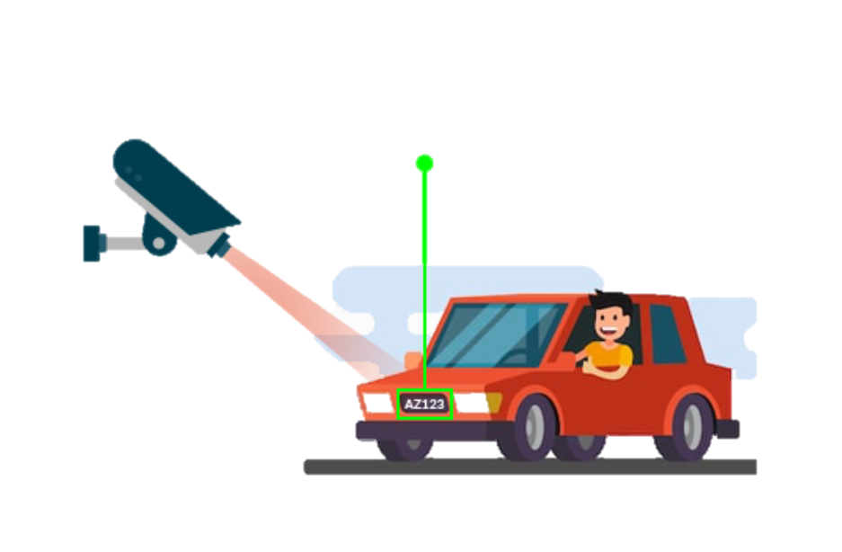
AUTOMATED VEHICLE ENTRY AND EXIT
TRACKING SYSTEM

Slide 2

Our team :
Athulraj B C
Baby Sherin
Rafeek R
Department :
School of Digital Sciences
College :
Kerala University of Digital Sciences, Innovation and Technology
Technocity Campus, Thiruvananthapuram, Kerala, India -695317

Slide 3
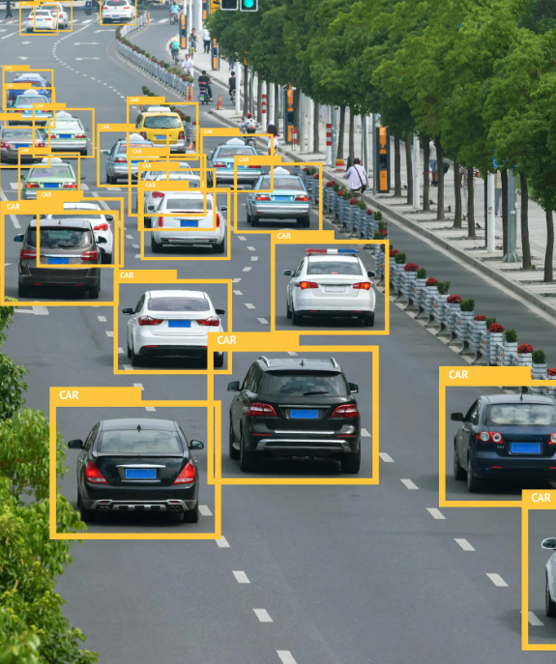

INTRODUCTION
Context and Problem Statement
In today's fast-paced world, institutions such as educational campuses, corporate parks, and residential complexes face increasing challenges in managing vehicle flow.
The primary issue revolves around effectively tracking and recording the entry and exit of vehicles, crucial for security, traffic management, and resource allocation.

Slide 4


Significance of Vehicle Tracking
Technological Solution
Accurate vehicle tracking is essential for:
Enhancing security by monitoring and logging vehicle movements.
Streamlining traffic flow within the premises to avoid congestion.
Ensuring proper utilization of parking spaces and related infrastructure.
It aids in emergency situations, allowing for quick identification of vehicle details.
Introduction of an Automated Vehicle Entry and Exit Tracking System:
YOLO (You Only Look Once): An advanced deep learning model used for real-time object detection. Recognizes and locates vehicles number plate.
Easy OCR: An Optical Character Recognition tool extracts and interprets number plate information from detected number plates.
Together, these technologies create a automated system

Slide 5
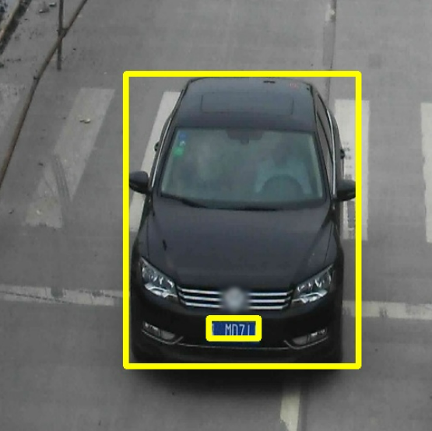
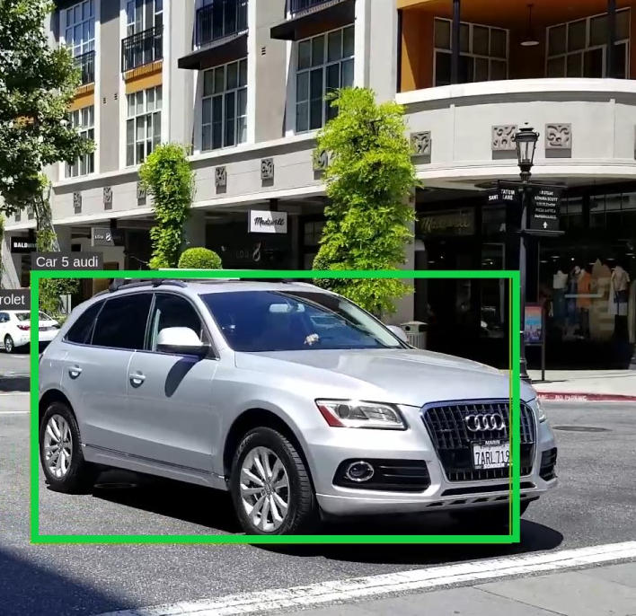
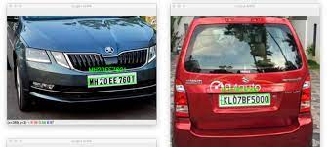
OBJECTIVES
Automating Vehicle Identification
Real-Time Entry and Exit Tracking
Enhancing Security and Operational Efficiency
Implementation in Institutional Settings

Slide 6
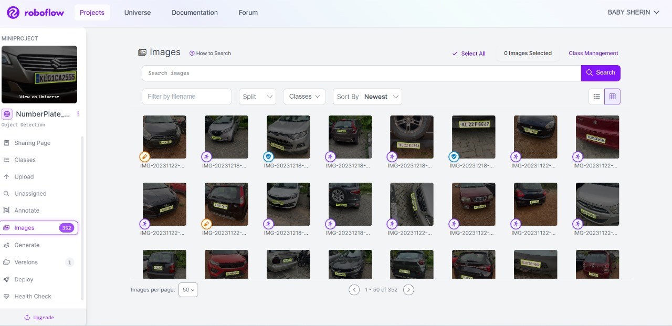
Data Collection
Dataset comprises 609 training, 57 validation, and 30 test images of various vehicles.
Manually annotated bounding boxes for each image.
Roboflow

Slide 7
Data Preprocessing
Auto-orientation adjustment and resizing to 640x640 pixels are applied.
Rotation augmentation (-15° to +15°) exposes the model to objects from diverse angles.
Grayscale additions (5%), saturation (-46% to +46%), and brightness adjustments (-25% to +25%) introduce a wider range of color and lighting conditions. Enhances the model's ability to handle diverse colour representations.
Minimal blur (up to 1px) and noise within bounding boxes (up to 1% of pixels) are incorporated.Bounding box adjustments (90° rotations and upside-down orientations) enrich the dataset, aiding the model in identifying objects in various orientations.

Slide 8
Model Summary
Yolo V8
Epoch = 150
mAP50 = 95%
mAP50-95 = 68.6

Slide 9
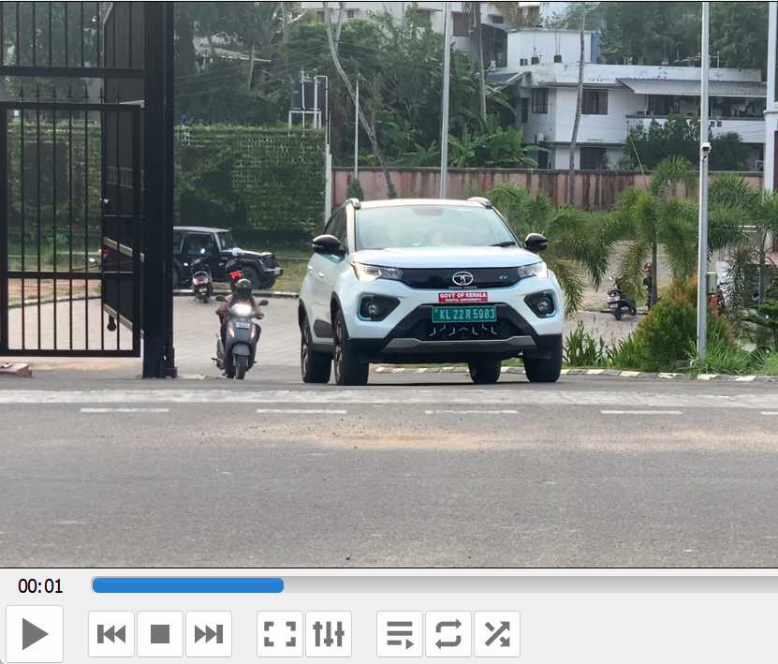
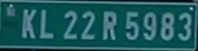
TECHNOLOGY OVERVIEW
YOLO (You Only Look Once)
A state-of-the-art, real-time object detection system.
Functionality:
Processes images in one pass, making it extremely fast.
Detects objects and their classifications simultaneously.
Application in Project:
Used for identifying vehicles numberplates in video feeds.
Enables the system to analyze video frames quickly, crucial for real-time tracking.

Slide 10
Easy OCR
An accessible and efficient Optical Character Recognition tool.
Capabilities:
Recognizes text from images, with support for multiple languages.
Highly accurate in extracting readable content from diverse backgrounds.
Role in the System:
Extracts number plate information from the detected vehicles.
Converts visual number plate data into digital text for processing and logging.
K L 22 R 5983

Slide 11
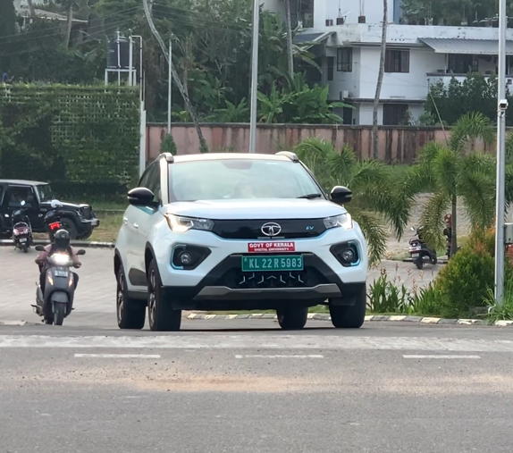

SYSTEM ARCHITECTURE
Object Detection
> = Confidence: 80%
Easy OCR
YOLO V8
Frame Slicing
Filtering
Capturing Video ( input)
Frames
Model
Object
Model For Character Detection
. , K L 22 |R 5983\
> = Confidence: 80%
Regex
K L 22 R 5983
car_records = {
"KL22R5983": {
"Entry": <entry_timestamp>,
"Exit": <exit_timestamp>,
"OCR Confidence": <entry_ocr_confidence>,
"Exit OCR Confidence": <exit_ocr_confidence>
}
}
One angle Exit Entry Logic
Filtering Repetition
Creating
Storing In DB
Creating Dictionary
Output
Dictionary Structure
Storage

Slide 12

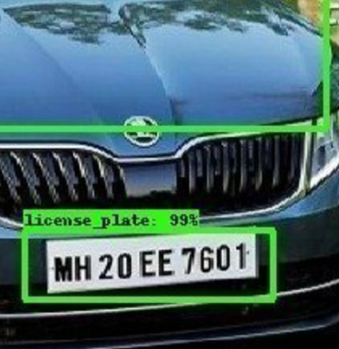


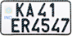

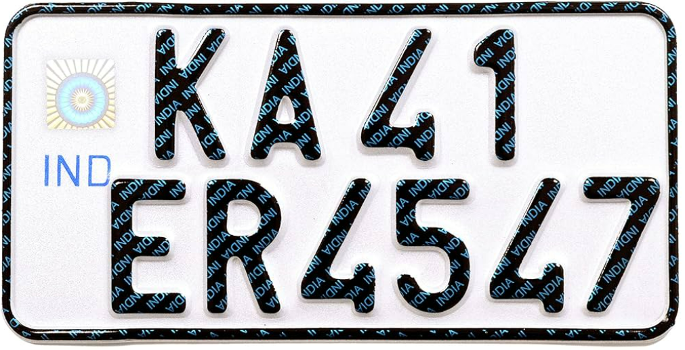


SYSTEM ARCHITECTURE
Video Input
Number Plate Extraction (Utilizing OpenCV)
Data Processing and Logging
Role: The starting point of the system.
Description: Cameras installed at strategic locations capture live video footage of vehicles entering and exiting the premises.
Role: Isolates the vehicle's number plate from the detected vehicle.
Description: Once a vehicle is detected, OpenCV processes the relevant portion of the video frame to extract the number plate area for further analysis.
Role: Organizes and stores the information.
Description: The system logs the recognized number plate data along with the corresponding timestamp of the vehicle’s entry or exit, creating a comprehensive record.
KA 41 ER 4547
Object Detection (Using YOLO)
Optical Character Recognition (Easy OCR)
Role: Identifies vehicles numberplate in the video frames.
Description: The YOLO model analyses the video feed in real-time, detecting vehicles numberplate by distinguishing them from other elements in the frame.
Role: Translates visual information into text.
Description: Easy OCR scans the extracted number plate images, recognizing and converting the alphanumeric characters into digital text

Slide 13
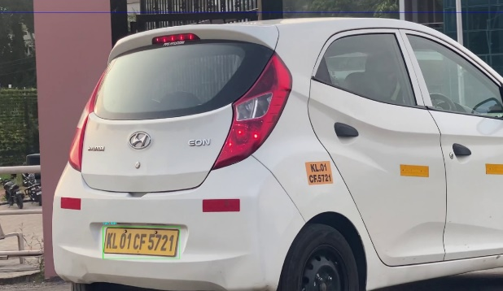
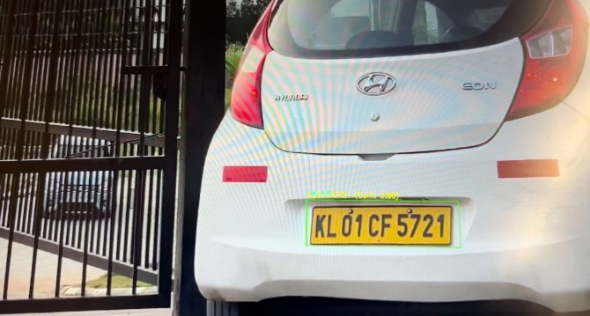
RESULT

Slide 14
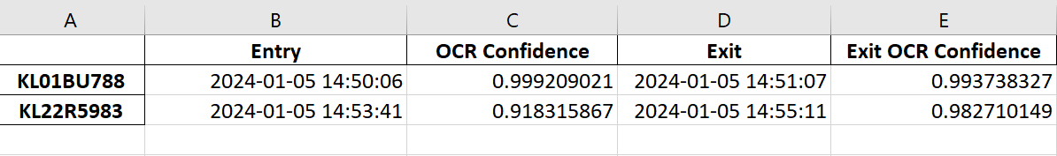
Output
Role: Final stage of the data flow.
Description: The system compiles and presents the logged data, which includes the vehicle number plate information and time stamps, ready for access and analysis.

Slide 15
Future Scope
We plan to implement a system that alerts security officers when an unauthorized vehicle is detected. This involves integrating a Raspberry Pi microprocessor and utilizing a Pi Cam camera module to develop a compact, portable device.
We also aim to create a website interface that can easily identify the vehicle owner using API’s
We can develop a centralized database to reduce amount of storage space and manage the storage of surveillance video recordings.

Slide 16
THANK YOU

